Slide 1
Analysis Report on Apex Store Data for 2012 – 2014
By kelvin

Slide 2
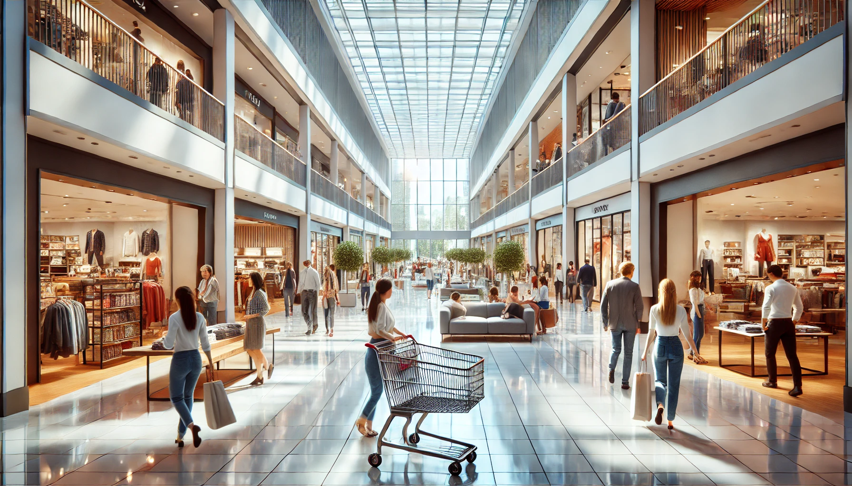
Hi …
Welcome to my first data analysis project
where I explore the shopping habits of customers
& factors that influence the loyalty of customers and
therefore promote sales.
With the advancement of technology,
customers shopping habits have evolved over the
years, making it crucial for businesses to keep up with
the trends and develop more efficient sales strategies.

Slide 3
Objective of Analysis
In this analysis, I aim to shed light on customers’ behavior and shopping habits and draw substantive conclusions that can serve as suggestions for making data driven decisions.
As noted earlier the retail industry is fast evolving, so how can businesses grow in the same manner? This is one of the questions this analysis answers by portraying trends in simple graphs, charts histograms etc.

Slide 4
Problem Statements
Customer Segmentation: How can customers be segmented based on their spending habits and demographics to improve target marketing.
Revenue Optimization: Which customer segments contribute the most to revenue, which product categories have the highest potential for increased sales.

Slide 5
Methodology
Data Collection: The data used in this analysis was gotten from the super_store data set which is available on kaggle. The Data set contains columns such as customer_id, date of transaction, reccency and other demographics (age, marital status and educational level)

Slide 6
For my analysis I made use of python libraries such as numpy for computational analysis,
Pandas for data manipulation and matplotlib for data visualization.
All analysis were performed in a Jupyter notebook, the file can be accessed on my Github
Pandas was used to read the data in a csv file, convert the data set into
a data frame(rows and columns).
I used numpy for aggregation of data using functions such as max, min, sum etc.
Next, I used the pyplot module from matplotlib to visualize the data, addressing the problem statements
such as the income distribution, product spending patterns, income of customers according to
certain demographics.

Slide 7
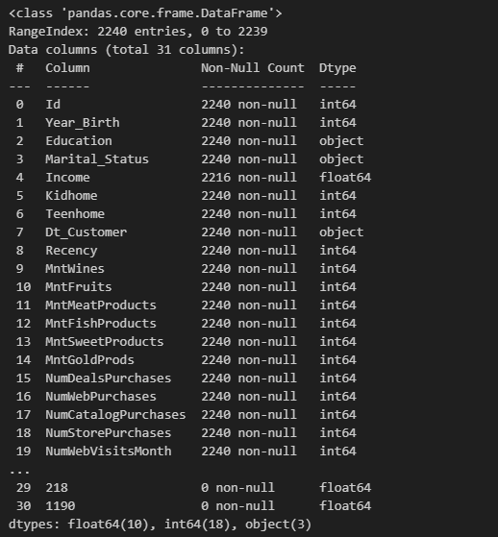
RESULTS
This is a brief info on our data set using the pandas info() function
This function summarizes the details of our dataset; columns, datatypes, null values etc.

Slide 8
Customer segmentation
This is where we group the customers to compare their spending habits, which products they prefer
and other factors that can influence their purchase power
To do this I extracted the customers demographics such as Income, Education level, marital status, and
amount spent on each product

Slide 9
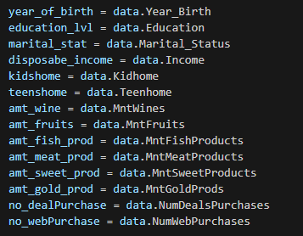

Slide 10
Income Distribution
What is the average purchase power of our customers
How is the income spread across the customer population, this would help determine company policies which would help customers who have a low income

Slide 11
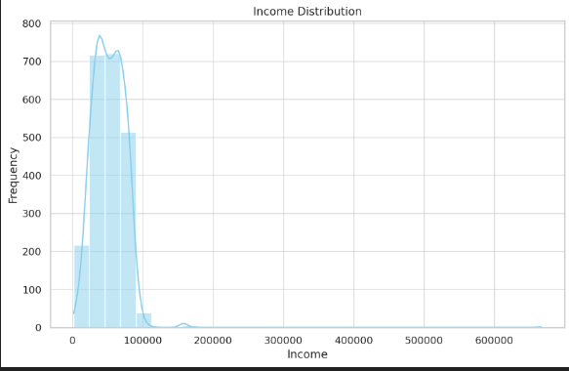

Slide 12
The income histogram reveals a wide income range, with a concentration around 30k-70k.
This suggests distinct customer segments with varied purchasing power, which could
influence spending patterns and marketing strategies.
The average income of the customers in the mall is $52247.25
51.61% of the total customers have a high income greater than $50000
This shows that the income distribution is wide with half of the customers
having a high income and different types with varying purchase power

Slide 13
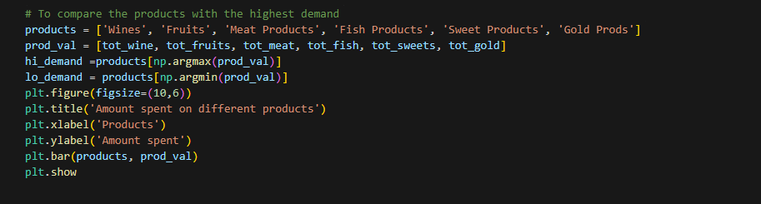
Which product is in high demand compared to other products

Slide 14
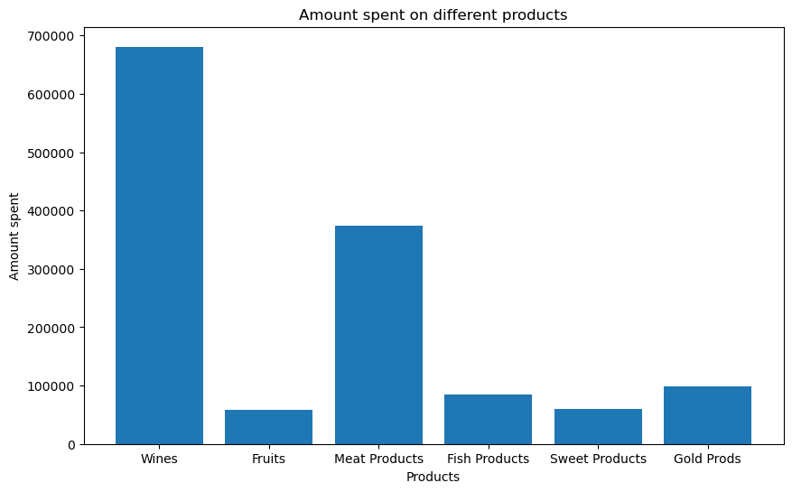
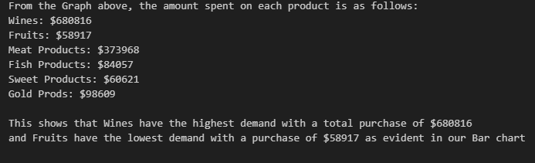

Slide 15
Spending by Product Categories
From the bar chart portrayed earlier customers spend the most on
wines, followed by meat and fish products.
This pattern suggests that promotions around wines and meat could yield high returns,
with potential for growth in other categories like sweets and gold products.
The Maximum Purchase made on each product is as follows:
Wines: $1493
Fruits: $199
Meat Products: $1725
Fish Products: $259
Sweet Products: $263
Gold Prods: $362

Slide 16
Which Marital status has the highest purchasing power
Can the marital status of customers affect their purchase power?
Lets answer this question in this analysis by comparing the incomes of singles, couples,
divorcees and individuals who are together

Slide 17
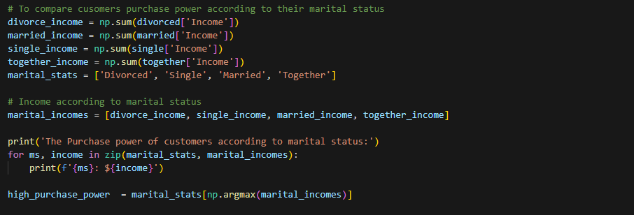

Slide 18
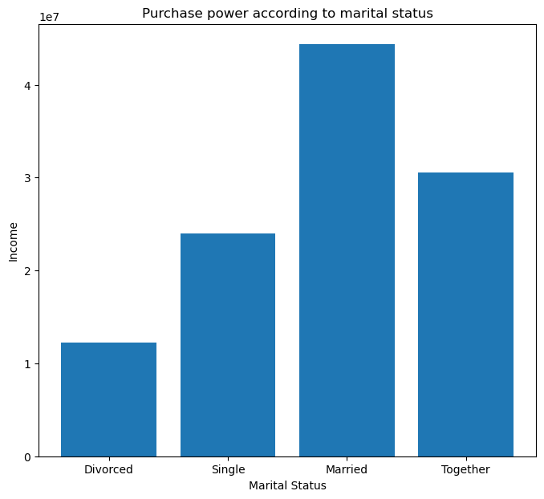
In the above code snippet we grouped the individuals into different marital status,
calculated the total income of each marital category and identified the category
with the highest purchase power
NOTE: The amount spent is in ten million dollars

Slide 19
Which Educational level has the highest purchasing power
Higher education generally boosts purchasing power by increasing income potential, improving financial literacy, providing job stability, and enhancing credit access, enabling smarter financial decisions and greater buying capacity.

Slide 20
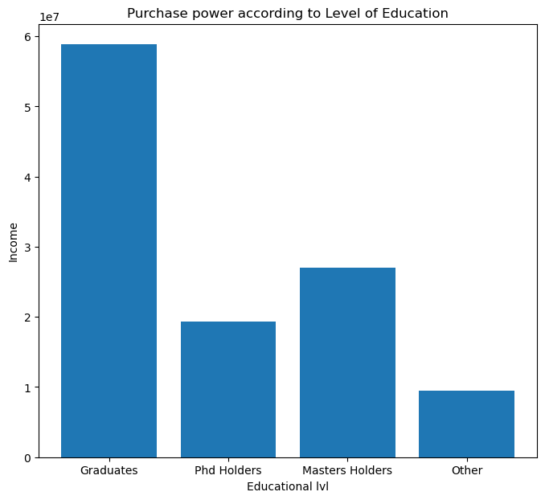
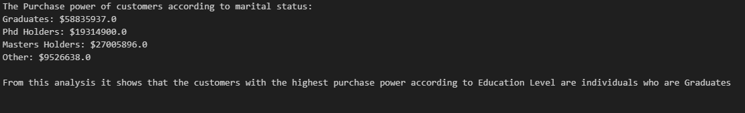

Slide 21
Conclusions
This analysis identifies three customer segments based on product demand, marital status, and educational levels. By targeting each segment—ranging from budget-conscious families to affluent high-spenders—with tailored marketing strategies, businesses can better meet customer needs and drive revenue growth.
This brings me to the end of my analysis you can view the notebook Here

